Slide 1

Cloud Migration

Slide 2
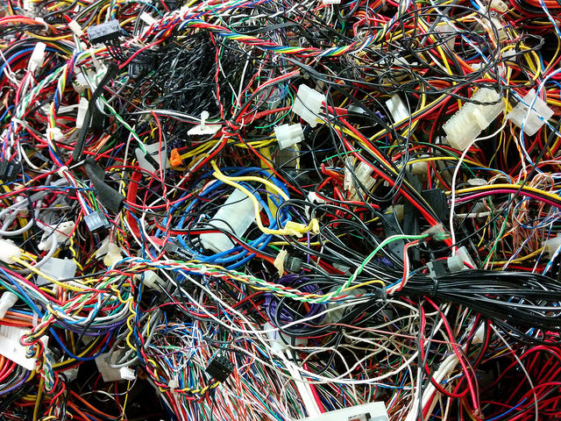
Identifying the Microservice & Monolithic Application?
Monolithic Application (Legacy Code)

Slide 3

Micro Service

Slide 4
Why Microservice Migration In First Place ?
Microservice hosted as a Single Application.
Easy to Lift & Shift the application to Cloud Environment.
Easy to Figure out the Errors.
Don’t have Multiple Teams Involvement.
Don’t have Complex Architecture.

Slide 5
Migration Plan
M1 – Setup Test Environment Application (include Testing)
Setup test environment in Cloud.
Verifying the test environment.
Being Tracked in Jira/Trello.
Target Date –
Status –

Slide 6
M2 - Setup Integration Environment Target Date – | Status –
Setup Integration Environment.
Proper Testing of Latest Deployed Code.
Being Tracked in Jira/Trello.
M3 - Performance Testing Target Date – | Status –
Performance testing of application.
Being Tracked in Jira/Trello.
This will be done in the Integration Environment

Slide 7
M4 – Production Environment Target Date – | Status –
Setup Production Environment.
Proper Testing of Latest Deployed Code.
Being Tracked in Jira/Trello.
M5 – Infrastructure Monitoring Target Date – | Status –
Setup Cloud Watch Dashboard.
Automated Warning/Critical Infrastructure Notification.
Being Tracked in Jira/Trello.

Slide 8
M6 – DNS Cutover Target Date – | Status –
Traffic Monitoring during Ramp- up
Traffic Ramp-up Plan
Ramp-up to 10% traffic for 2 days
Ramp-up to 30% traffic for 2 days
Ramp-up to 50% traffic for 2 days
Ramp-up to 100% traffic

Slide 9
M7 – Secondary Region for DR Target Date – | Status –
Setup Data Recovery Environment.
Verifying DR Environment.
Being Tracked in Jira/Trello.
M8 – Setup Auto failover Target Date – | Status –
DNS Failover Changes.
Reduce the TTL value as much as possible, recommendation to make it 60 Sec.

Slide 10
M9 – Burn Down Activity Target Date – | Status –
Resource Utilization.
Verifying Resilience Plan.
M10 – Data Center Decommissioning Target Date – | Status –
Decommission the Data Center Servers.

Slide 11
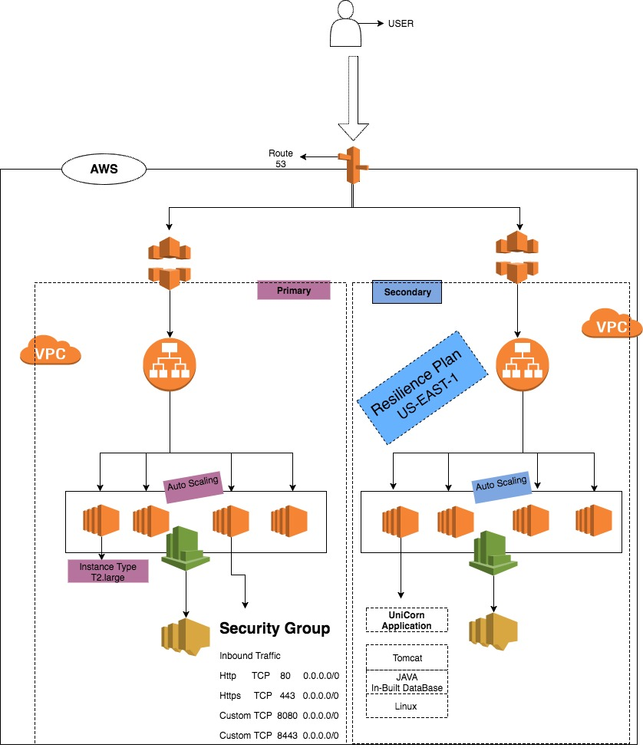
AWS Architecture

Slide 12
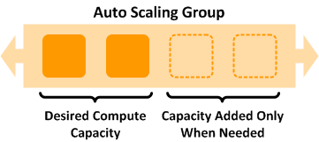
Why Auto Scaling ?

Slide 13
Auto Scaling Policies
CPU Utilization > 70 for 2 consecutive period of 300 second -> Add 1 Instance.
CPU Utilization > 80 for 2 consecutive period of 60 second -> Add 2 Instance.
CPU Utilization > 40 for 2 consecutive period of 600 second -> Remove 1 Instance

Slide 14
Cloud Watch Dashboards
Monitor Cloud Resource
Set Critical Alarms
Monitor Custom Metrics
View Graphs and Statistics

Slide 15
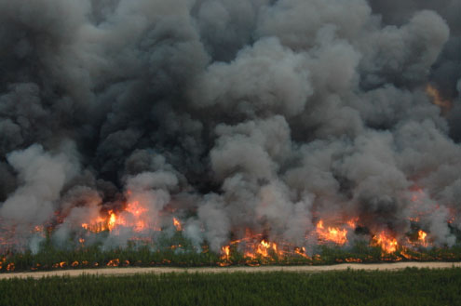
Why Resilience Plan Needed ?

Slide 16
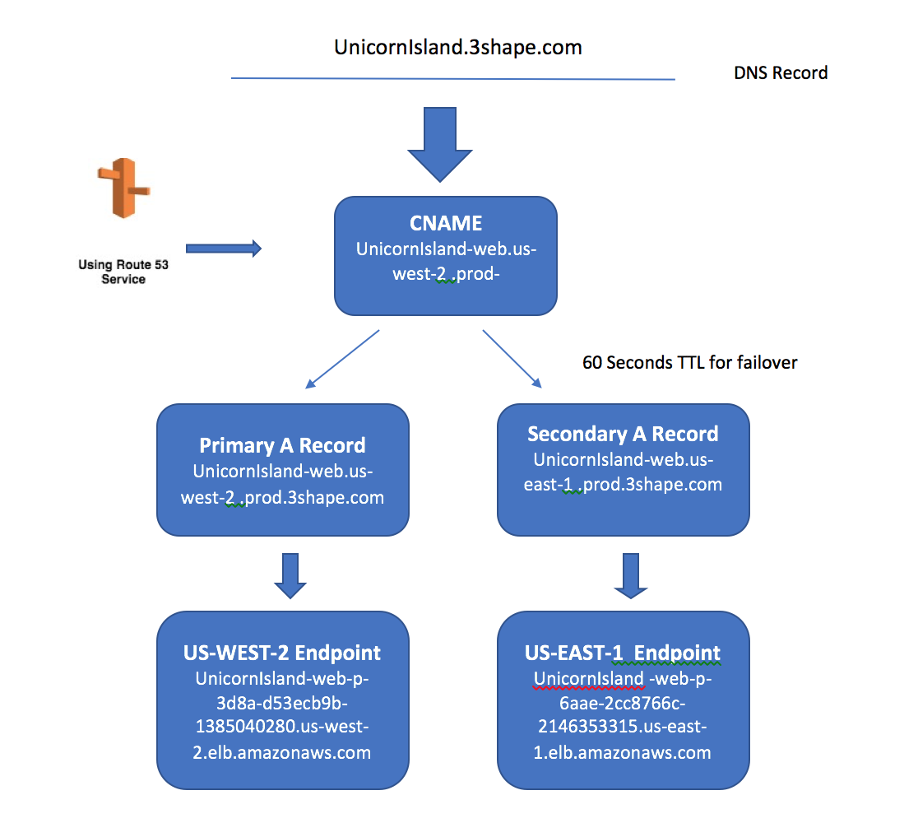
How AWS Router53 Works ?

Slide 17
Questions ?

